Slide 1
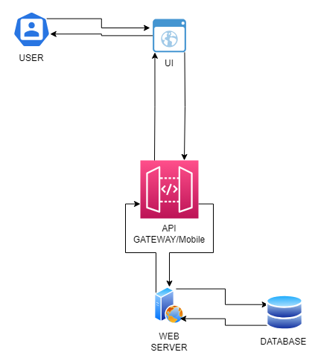
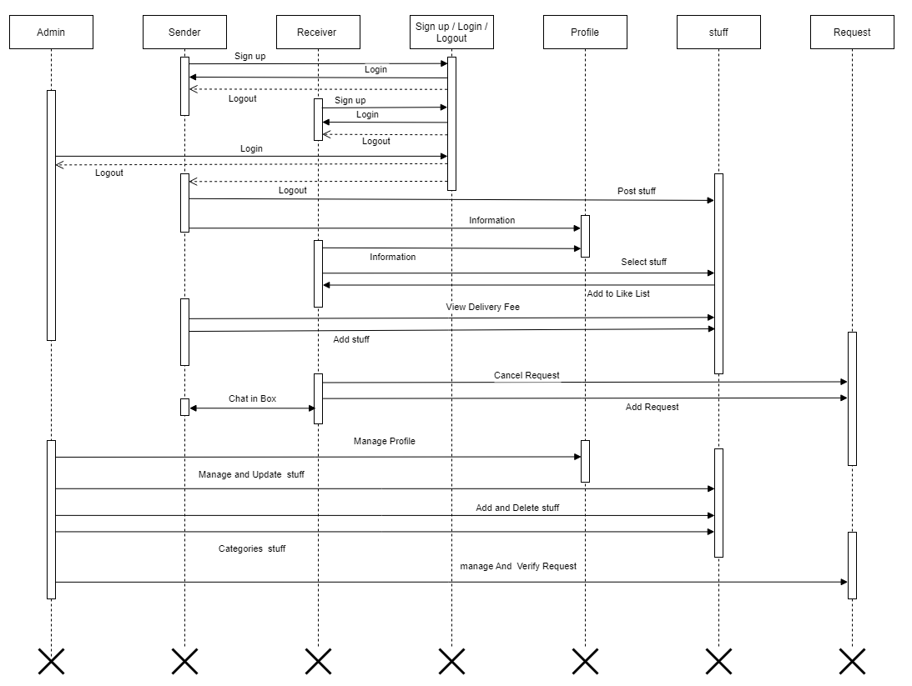


    Giveaway Stuff
    Ali Raza Arshad F2019105036
    M. Murtaza Arshad F2019065101
    M. Usman Ghani F2019266154
    Supervisor’s Name: Mr. Abdul Jamil
Abstract
Approach
The Giveaway Stuff platform is a project developed by students in their final year of the Bachelor of Science in Information Technology program. The platform aims to create an inclusive and respectful environment for users to share their unneeded possessions with others. The objective is to foster a sense of community and promote the repurposing of belongings while avoiding the use of the term "charity" to eliminate any potential feelings of dishonor or disgrace. Where everyone has the option to give and take stuff at any time and anywhere. Many users get confused while searching for desired stuff. Traditionally, if a person wants to give something, he makes a lot of physical effort, which takes time and energy, but our platform will allow them to give their stuff with a click while sitting at home, in the office, or wherever. On the other hand, if a person wants to buy something, he sometimes cannot find it within his budget or free of charge. To that end, our platform assists them in locating stuff that is both affordable.
React.js (for front-end development)
Visual Studio Code (for IDE)
Node JS and Firebase DB (for back-end development)
Flutter (for cross-platforms)
Firebase DB (For the real-time database)
Motivation
Giveaway Stuff aims to address the issue of excess assets that many individuals accumulate over time, which often go unused. By providing a platform for users to share their unneeded belongings, the project seeks to reduce unnecessary stuff. The motivations behind the Giveaway Stuff platform encompass community building and promoting a culture of sharing.
Objectives
Results
Conclusion
Create a user-friendly platform enabling individuals to share their unneeded possessions.
Foster a sense of community and connection among users through the act of giving and receiving.
Provide a convenient and efficient way for users to browse, search, and communicate with each other to arrange pickups or deliveries.
Cultivate a culture of sharing and generosity where individuals feel empowered to contribute to the well-being of others.
Ensure a respectful and inclusive environment where all users are treated with dignity and gratitude for their participation.
  %Completion
  Total requirements: 16
  Requirements fulfilled: 13
  Completion percentage: (13 / 16) * 100 = 81%
  %Accuracy
  Total test cases: 14
  Requirements fulfilled: 12
  Accuracy percentage: (12 / 14) * 100 = 86%
  %Correctness
  Total test cases: 14
  Coverage fulfilled: 12
  Correctness percentage: (12 / 14) * 100 = 86%
The Giveaway Stuff platform has been successfully developed and implemented, providing users with a convenient way to share unneeded items with others. The platform's features, including user registration, asset selection, and rating functionality, offer a seamless experience for senders and receivers. While there are certain limitations, such as the absence of receiver and sender protection, users are advised to exercise caution and make informed decisions. Going forward, we will continue to enhance the platform based on user feedback and strive to create a sustainable and engaging sharing community. We express our gratitude to all stakeholders involved in the project's success.
References
Jamal and H. McKinnon, The Power of Giving: How Giving Back Enriches Us All. Penguin, 2008.
J. Santi, The Giving Way to Happiness: Stories and Science Behind the Life-Changing Power of Giving. Penguin, 2015.
Asada and A. Arai, “Post-Event Effects: A New Perspective on Giveaway Stuff Distributed at Sporting Events,” Journal of Global Sport Management, vol. 8, no. 1, pp. 281–301, Sep. 2020, doi: 10.1080/24704067.2020.1819618.
Ewraniwego, “Simple Giveaways – Grow your business, email lists and traffic with contests,”.
T. Brower Ph.D., “Giving Is Good—For Others, But Also for You,” Forbes, Nov. 28, 2021. [Online].
Acknowledgments
Our heartfelt acknowledgment goes to our project supervisor, Sir Abdul Jamil, for his invaluable guidance, expertise, and unwavering commitment. We are grateful to our esteemed faculty members and mentors for their contributions to our academic and professional growth. We also express our thanks to our families and friends for their unwavering support and understanding throughout this endeavor. Our appreciation extends to our university, institution, and the Information Technology Department at UMT for providing the necessary resources

